Slide 1
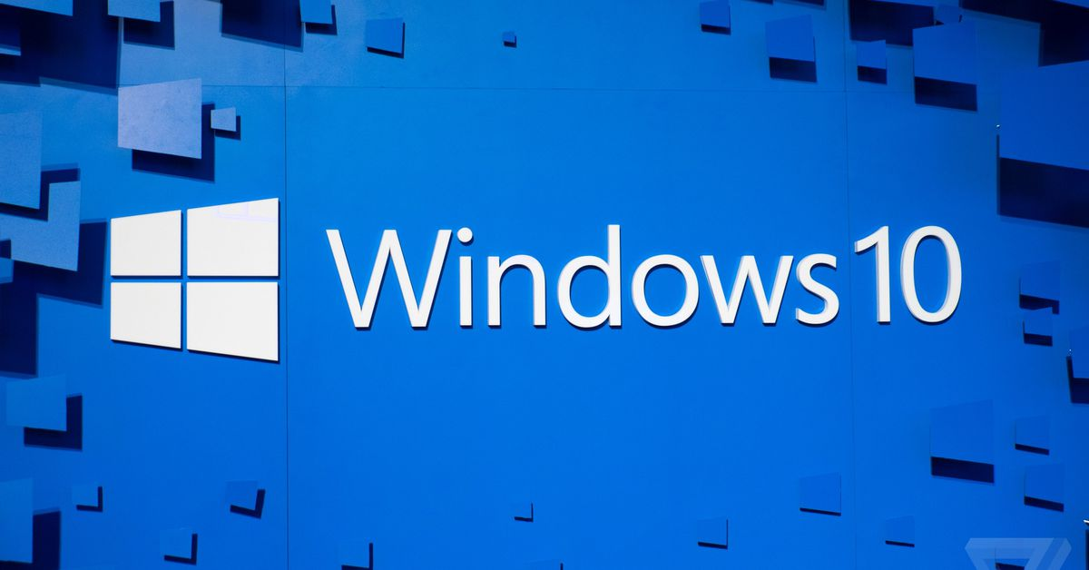
AL-Zahraa College of Medicine
Windows 10
Lecture 2
By Dr. Waleed Noori Hussein
AL-Zahraa College of Medicine
University of Basrah
University of Basrah – AL-Zahraa College of Medicine

Slide 2
Objectives
اهداف المحاضرة
To familiarize students with windows 10
To understand windows 10 features
AL-Zahraa College of Medicine –University of Basrah
1

Slide 3
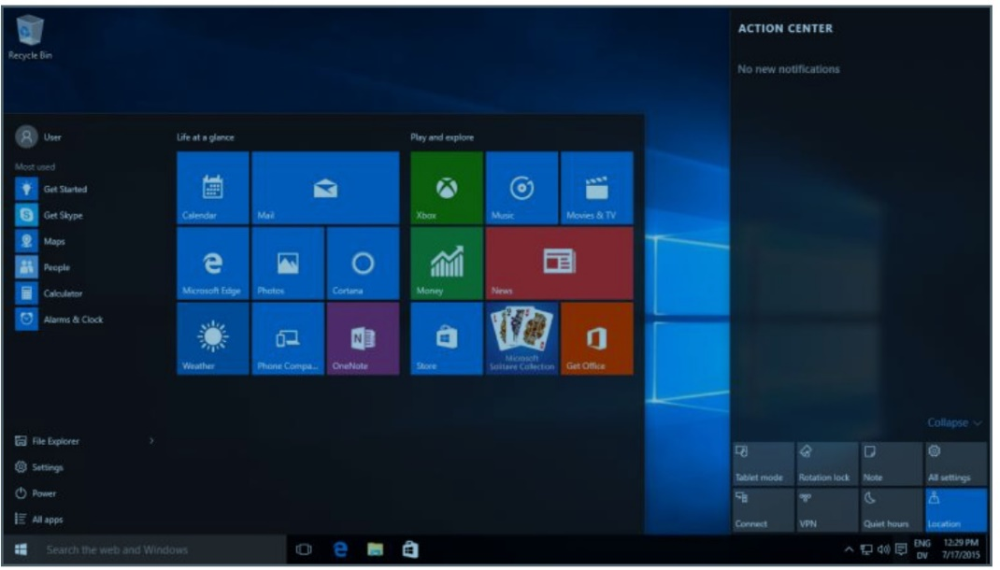
Windows 10
AL-Zahraa College of Medicine –University of Basrah
2

Slide 4
Windows 10
Windows 10 is one of Microsoft’s biggest updates ever to Windows.
Windows 10 is a series of operating systems developed by Microsoft and released as part of its Windows NT family of operating systems.
AL-Zahraa College of Medicine –University of Basrah
3

Slide 5
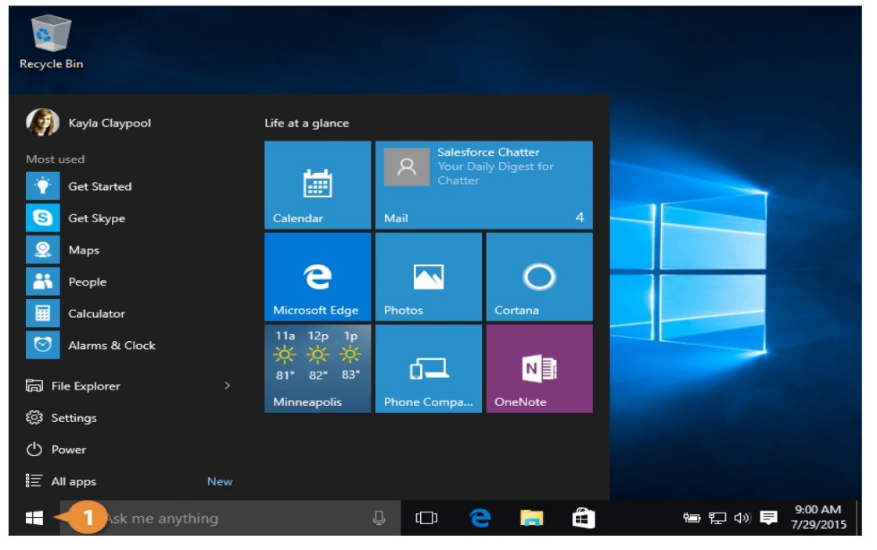
The Start Menu
AL-Zahraa College of Medicine –University of Basrah
4

Slide 6
The Start Menu
Some apps can be displayed as Live Tiles, which can show information from that app. For example, Mail messages will be summarized in the Mail app's tile, while the Weather app's tile will show your weather forecast.
AL-Zahraa College of Medicine –University of Basrah
5

Slide 7
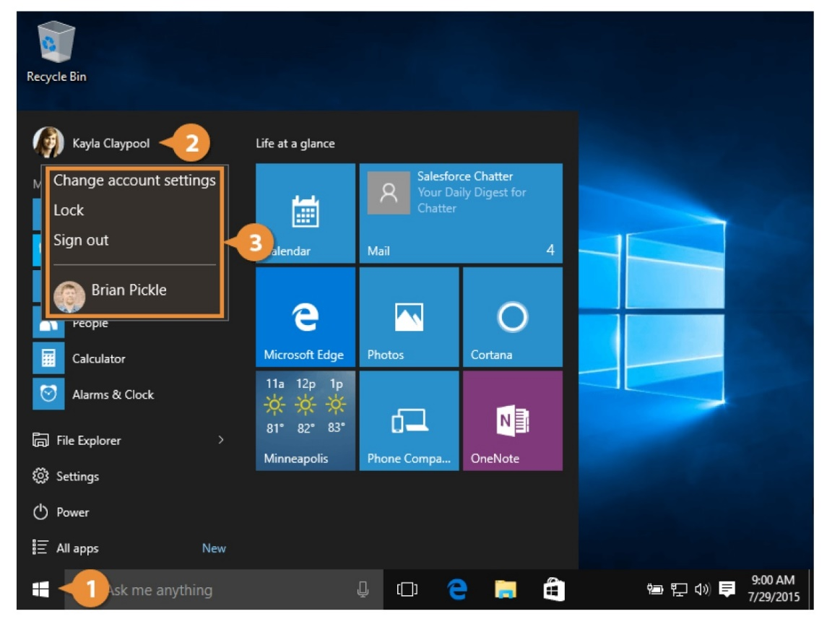
The Start Menu
Change account settings: Lets you make changes to your Microsoft account, including your picture, password, and other options.
Lock: Locks your computer, requiring a password to use it again.
Sign out: Signs your account out of Windows, so another user can login.
AL-Zahraa College of Medicine –University of Basrah
6

Slide 8
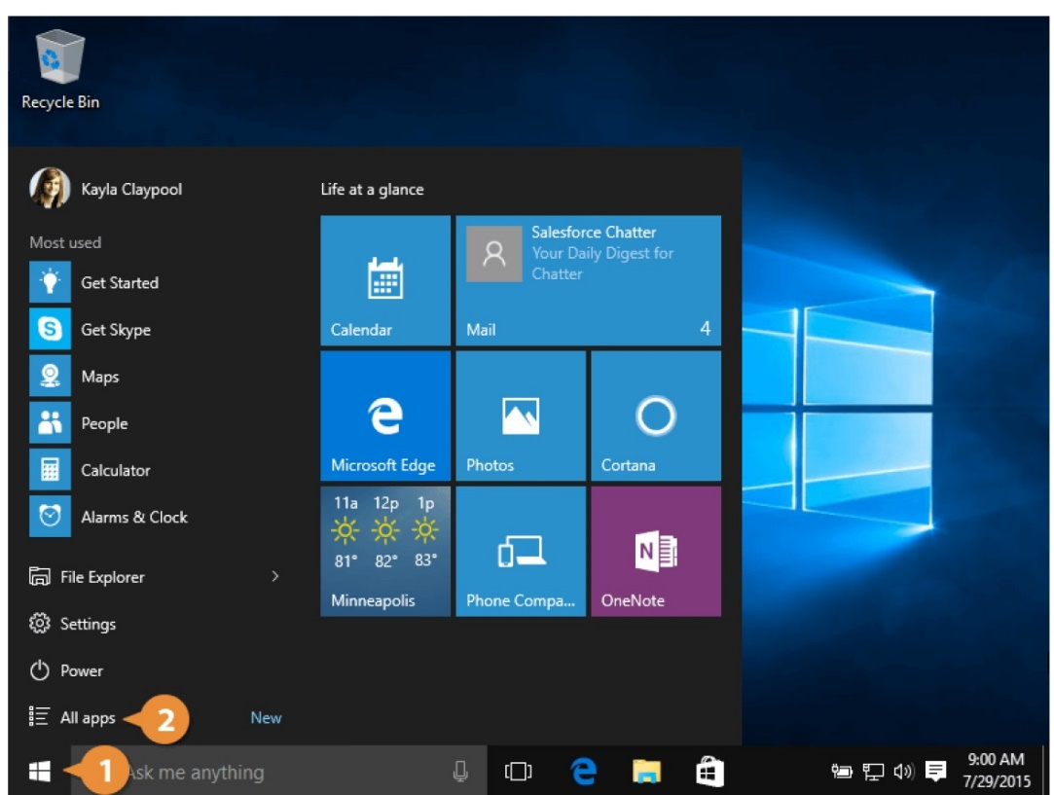
View and Start Apps
AL-Zahraa College of Medicine –University of Basrah
7

Slide 9
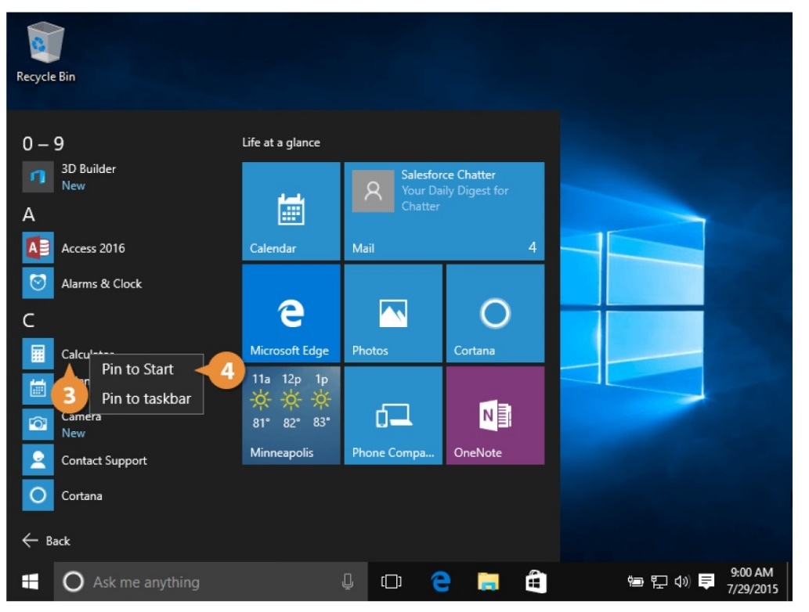
Pin Apps to the Start Menu
You can add or “pin” frequently used apps to the start menu for quick access.
AL-Zahraa College of Medicine –University of Basrah
8

Slide 10
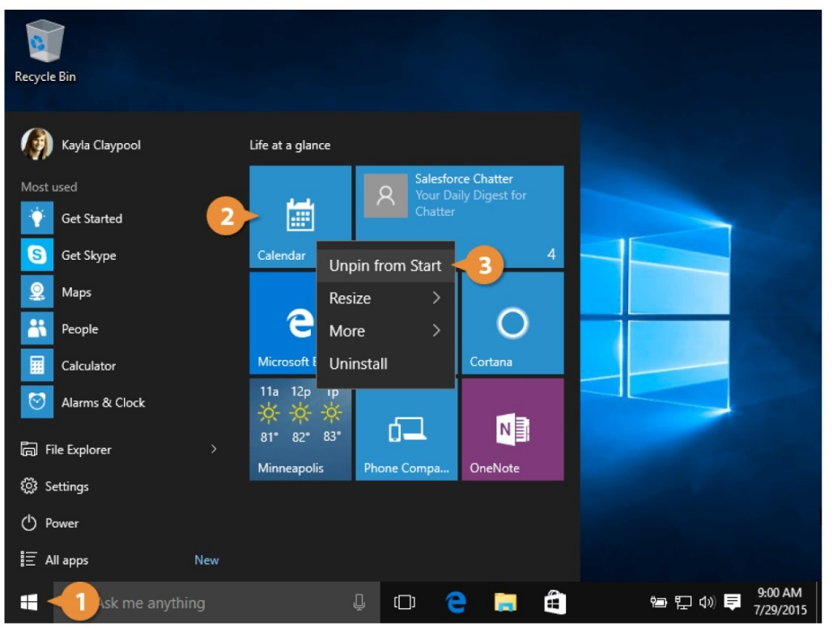
Remove a Pinned App
AL-Zahraa College of Medicine –University of Basrah
9

Slide 11
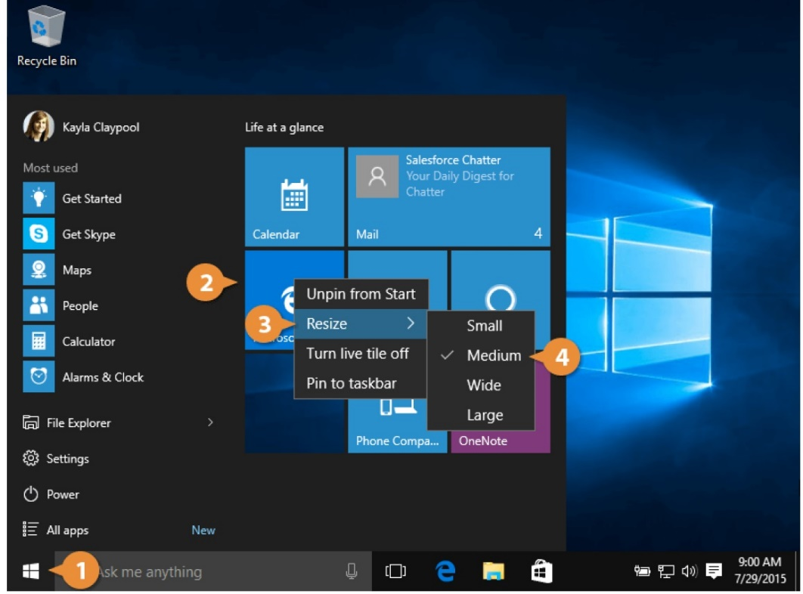
Resize an App Tile
AL-Zahraa College of Medicine –University of Basrah
10

Slide 12
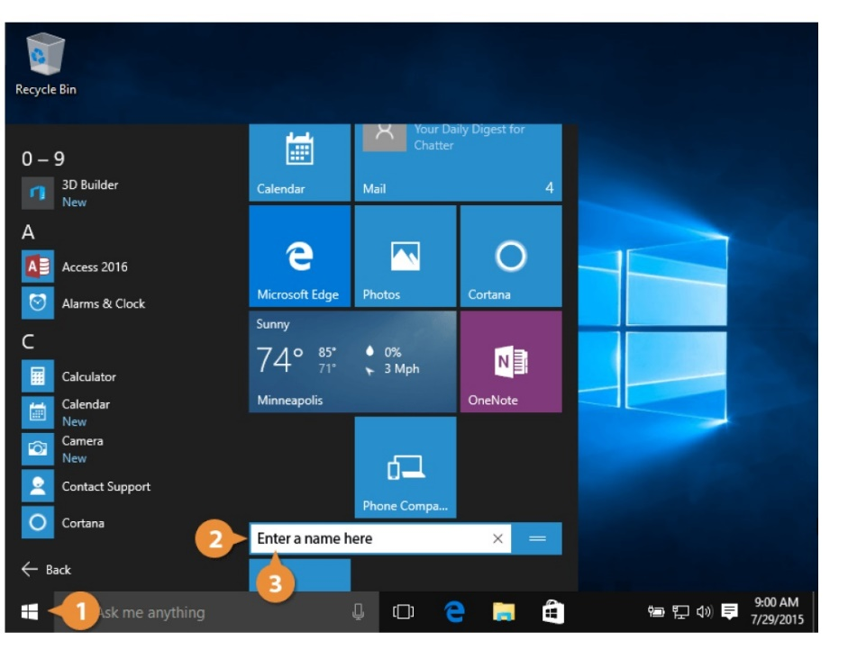
Rename a Tile Group
AL-Zahraa College of Medicine –University of Basrah
11

Slide 13
Notifications Pane and Action Center
Notifications Pane and Action Center The Action Center is a united place for all system notifications, such as incoming emails, and quick access to various system settings.
AL-Zahraa College of Medicine –University of Basrah
12

Slide 14
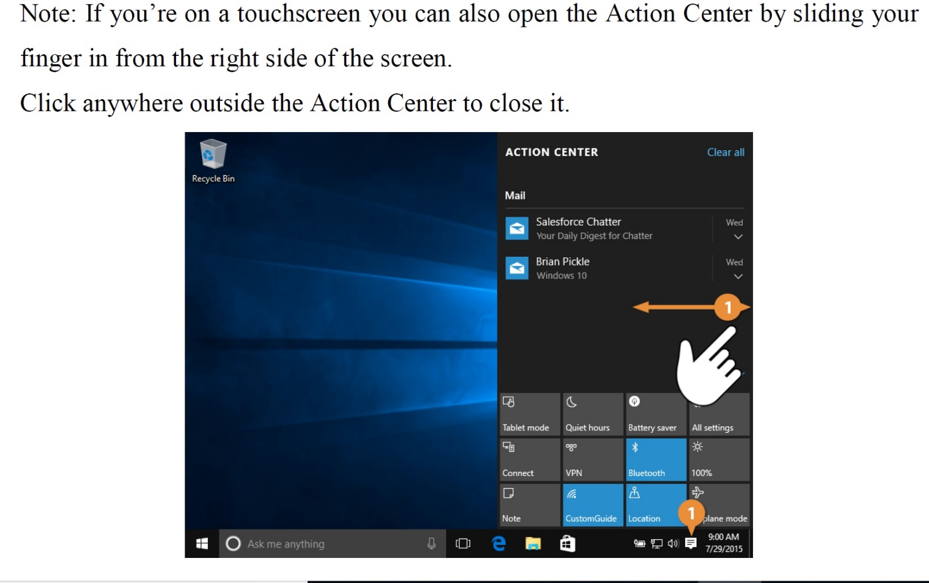
Notifications Pane and Action Center
AL-Zahraa College of Medicine –University of Basrah
13

Slide 15
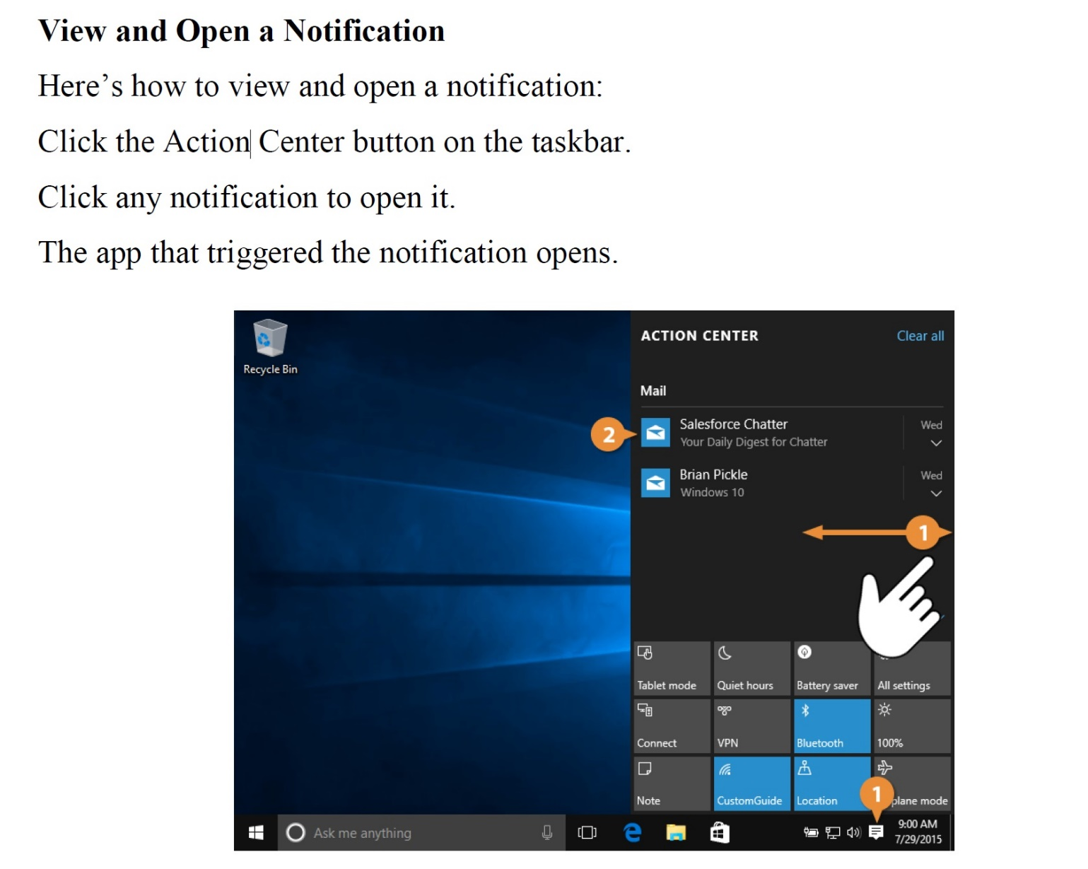
Notifications Pane and Action Center
AL-Zahraa College of Medicine –University of Basrah
14

Slide 16
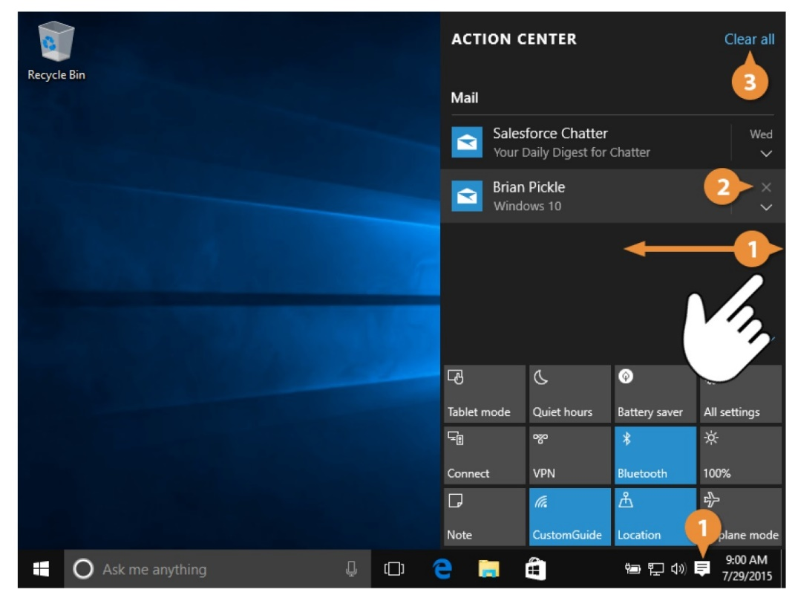
Notifications Pane and Action Center
Dismiss a Notification
AL-Zahraa College of Medicine –University of Basrah
15

Slide 17
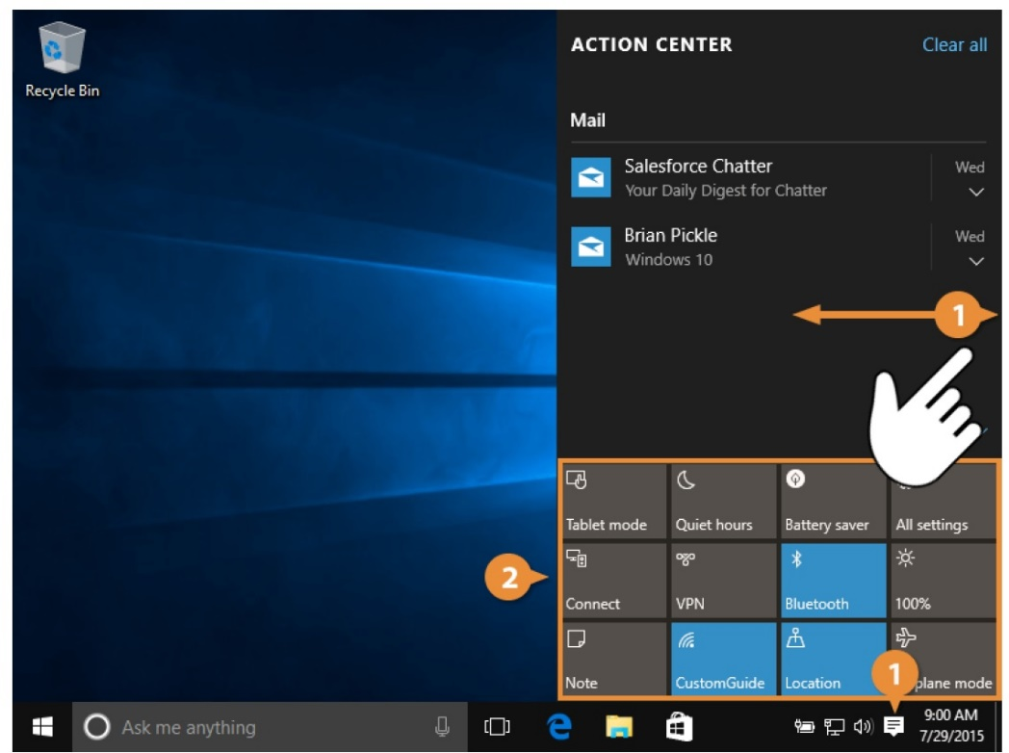
Notifications Pane and Action Center
Use Actions
At the bottom of the Action Center is a grid full of buttons. These quick toggles let you do a lot with just a few clicks.
AL-Zahraa College of Medicine –University of Basrah
16

Slide 18
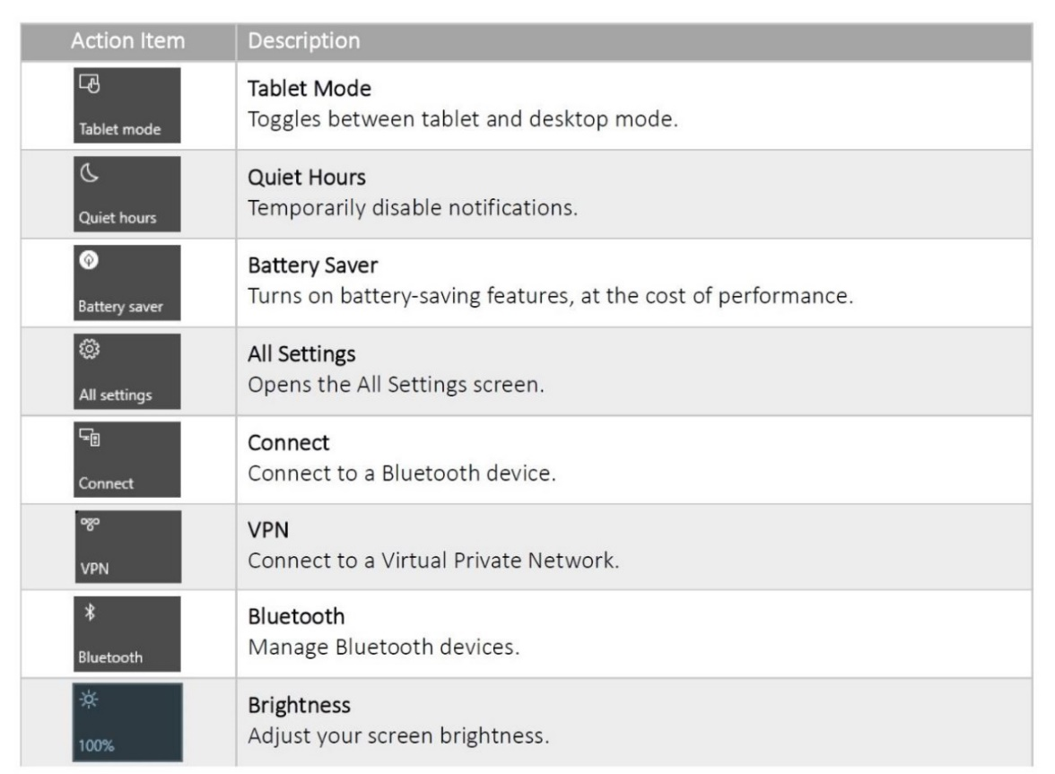
Notifications Pane and Action Center
AL-Zahraa College of Medicine –University of Basrah
17

Slide 19
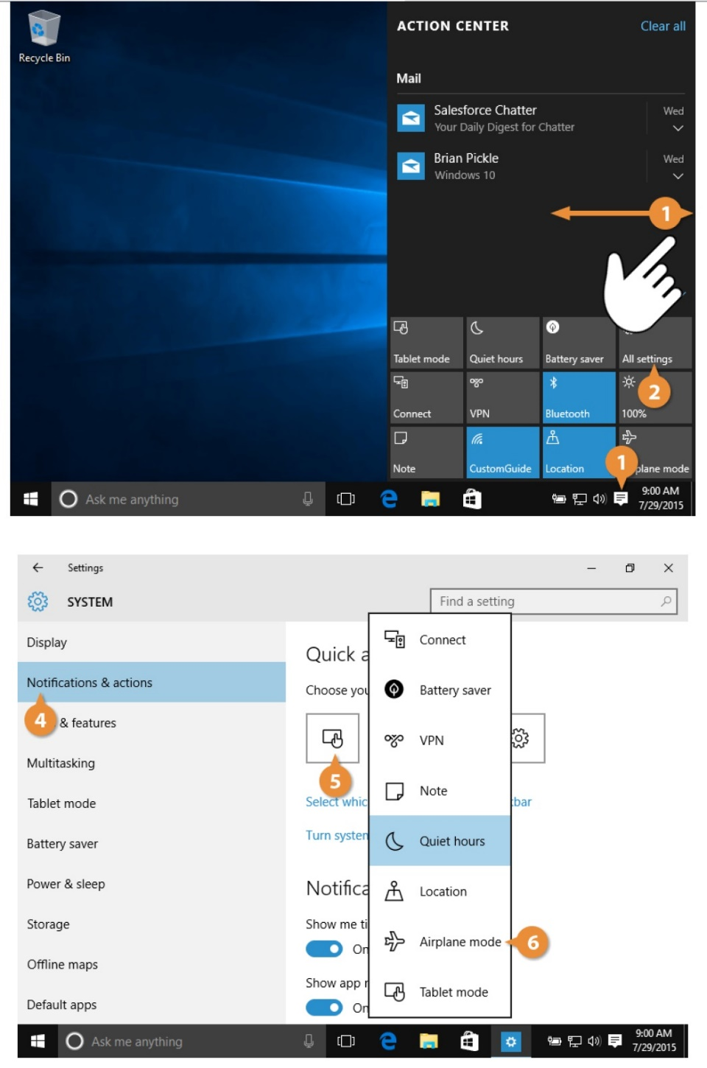
Customize Quick Actions
AL-Zahraa College of Medicine –University of Basrah
18

Slide 20
Microsoft Edge
Microsoft Edge
Windows 10 includes a new web browser, called Edge. Compared to Internet Explorer, Edge is faster, more secure, and more compliant with common web standards. Edge replaces Internet Explorer as the first app that's automatically pinned to the taskbar.
AL-Zahraa College of Medicine –University of Basrah
19

Slide 21
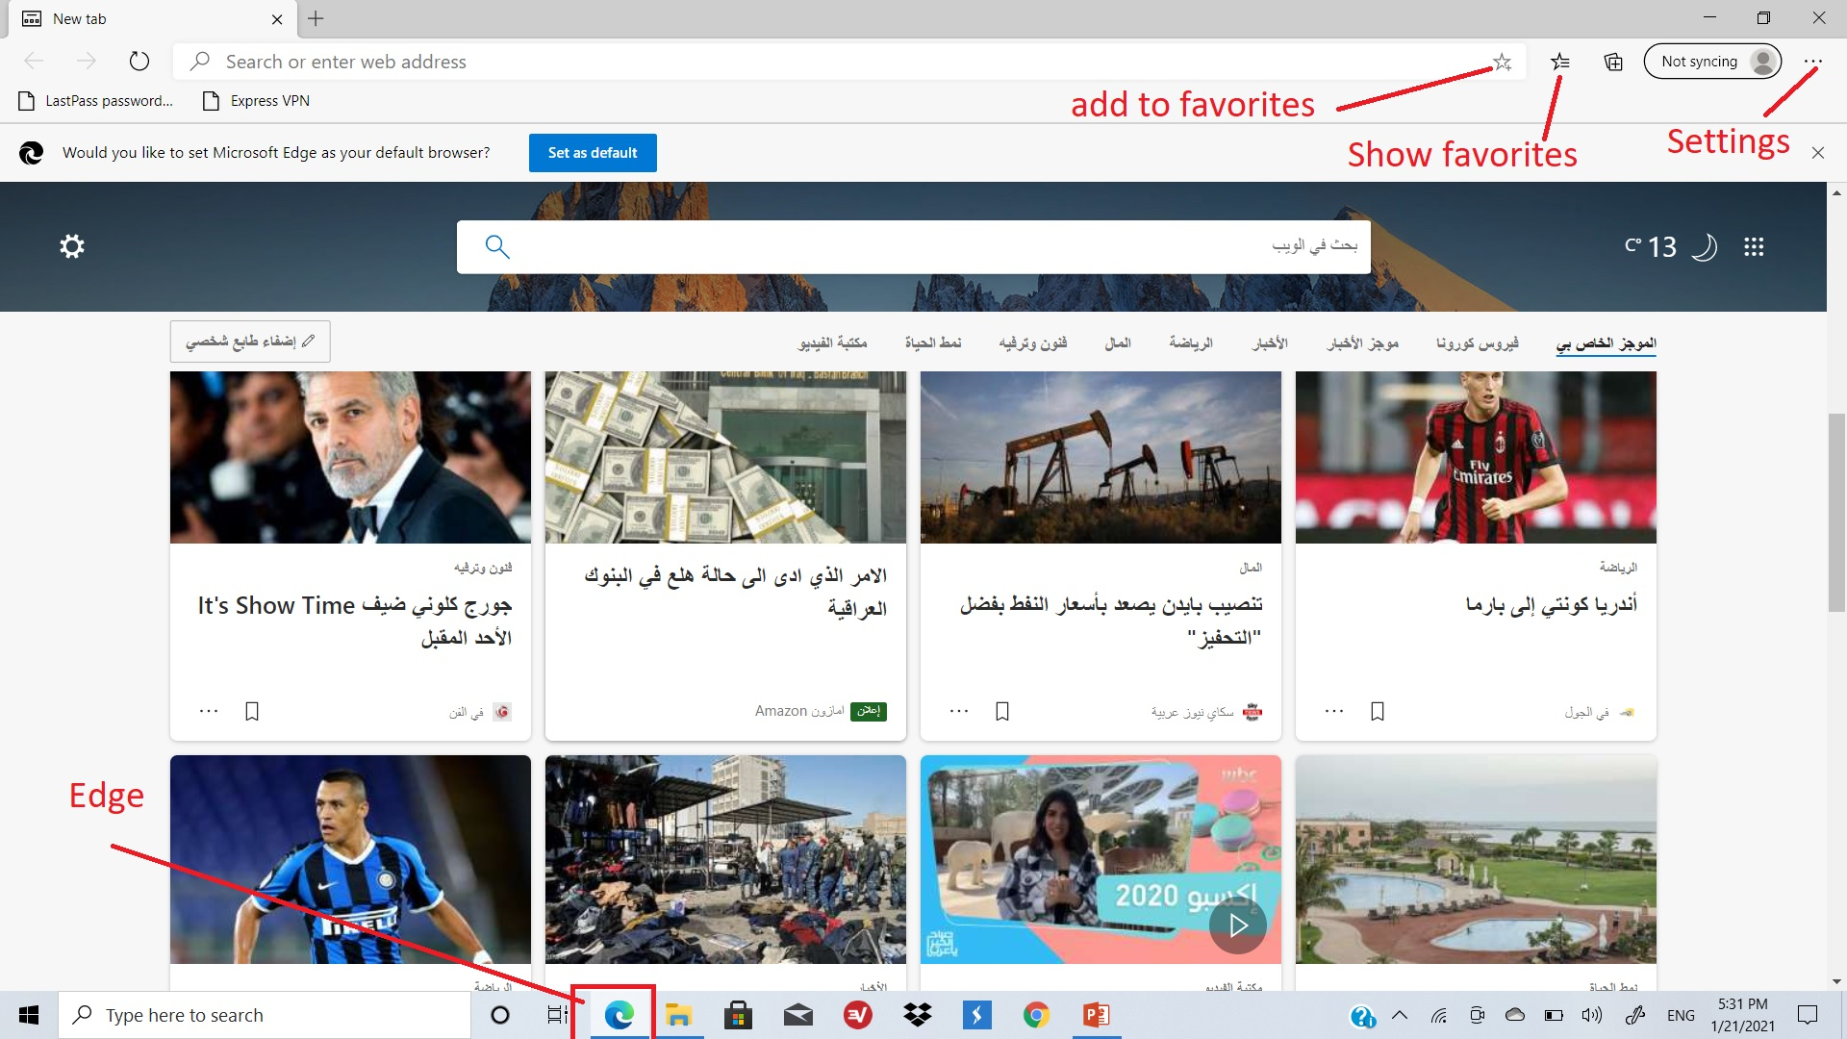
Microsoft Edge
AL-Zahraa College of Medicine –University of Basrah
20

Slide 22
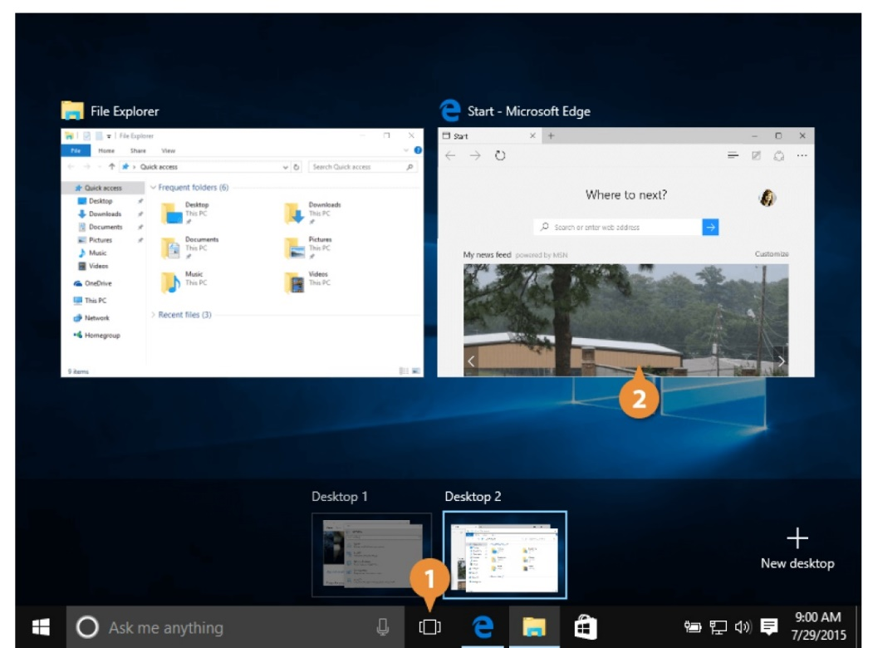
Windows 10
Use Multiple Desktops
Another new feature in Windows 10 is Task View, which lets you have several desktops open.
A desktop is a set of apps that are saved on the same page. If you have a lot of apps that you're switching between, you can group them into a few different desktops and then switch between desktops instead of constantly minimizing one window to get to another.
AL-Zahraa College of Medicine –University of Basrah
21

Slide 23
View Windows and Desktops
Here’s how to view your open windows and desktops:
Click the Task View button on the taskbar.
Note: You can also press windows logo key + D.
All the windows you have open are reduced to thumbnails, letting you switch between apps quickly.
Click the window or desktop you want to view.
AL-Zahraa College of Medicine –University of Basrah
22

Slide 24
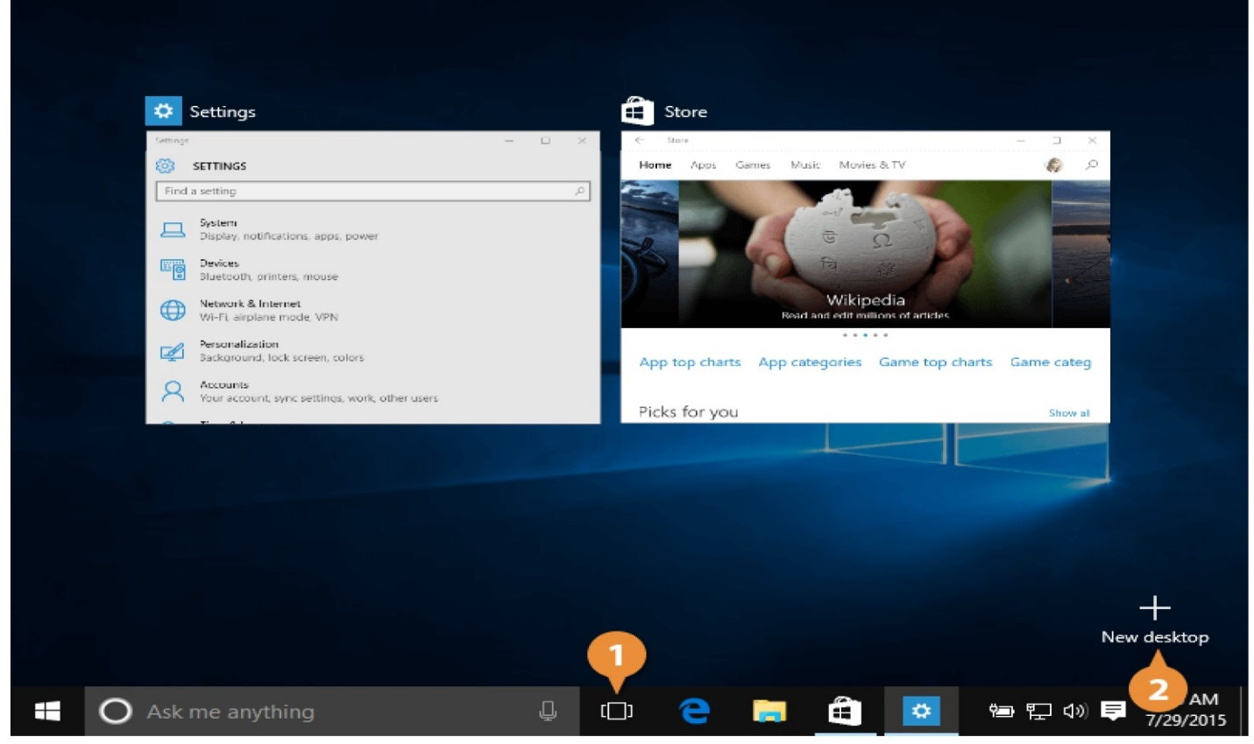
New desktop
AL-Zahraa College of Medicine –University of Basrah
23

Slide 25
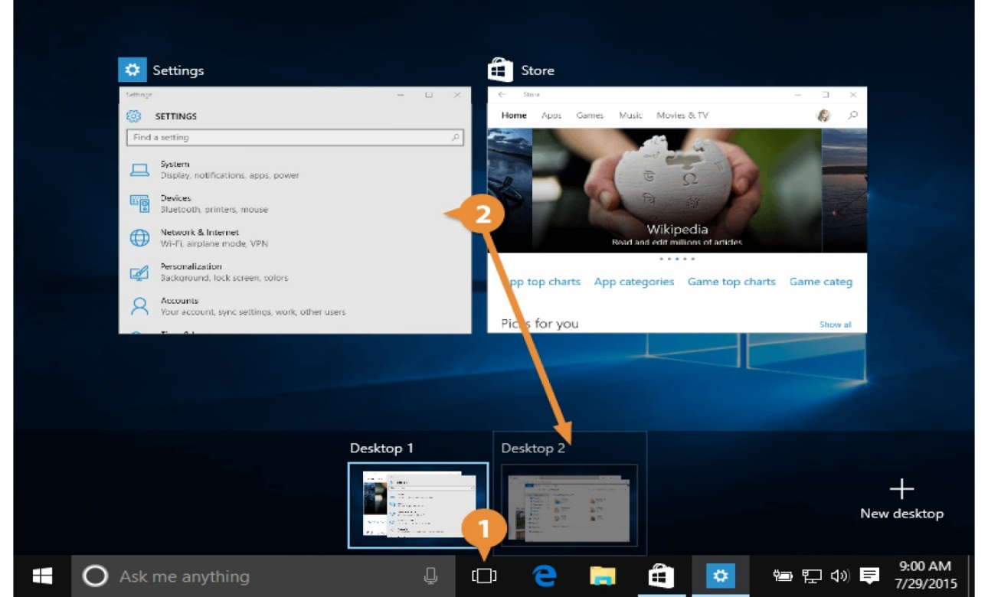
Move Windows between Desktops
AL-Zahraa College of Medicine –University of Basrah
24

Slide 26
Remove a Desktop
Remove a Desktop
Once you're done with a desktop, you can get rid of it. Click Task View button. Click a desktop’s close button. That desktop closes. If you had any apps still running on that desktop, they'll move over onto the next available desktop.
AL-Zahraa College of Medicine –University of Basrah
25

Slide 27
Windows 10
Reference
Windows 10 step by step, Joan Lambert & Steve Lambert
AL-Zahraa College of Medicine –University of Basrah
26

Slide 28
Windows 10
End session Questions
How to connect computer to projector ?
How to change background of desktop ?
How to access Regional and language options ?
How to access Windows firewall ?
How to find control panel in windows 10 ?
AL-Zahraa College of Medicine –University of Basrah
27

Slide 29
Windows 10
Thank you
AL-Zahraa College of Medicine –University of Basrah
28

